Slide 1




Education
University
01
Red Sea Treasure Hunt
An interactive strategy-based adventure game featuring Columbus navigating a grid-based Red Sea world filled with pirates, monsters, and hidden treasures. Built using Java (backend) and React (frontend).

Slide 2

Introduction
- A sea adventure game based on pirate treasure hunting.
- Built in Java (backend server) and React (frontend GUI).
- Player (Christopher Columbus) navigates grid to find hidden treasure.
- Avoid pirate ships, sea monsters, whirlpools, and obstacles.

Slide 3
How the Game Works
✅ 1. Game Initialization
On "New Game", the backend (GameState.java) spawns the player ship, pirates, sea monsters, whirlpools, and islands based on difficulty level.
Ship is wrapped with ShieldedShip to enable Boost and Shield functionality.
✅ 2. Player Movement
Each key press or button click triggers the move(String direction) method in GameState.
Movement logic checks:
If the move is within bounds.
If boost is activated (move 3 steps instead of 1).
If the ship hits a whirlpool or island.
✅ 3. Boost & Shield Logic
BoostManager tracks turn count and makes Boost available every few moves.
When Boost is used, ShieldedShip.activateBoost() is triggered.
Shields are reduced if a pirate collides with the ship. If shields = 0 → game ends.
✅ 4. Enemy Behavior
PirateManager handles pirate movement based on Strategy (e.g., ChaseStrategy or PatrolStrategy).
Pirates freeze for 3 turns if the ship enters an island.
SeaMonsterManager periodically spawns new monsters.
✅ 5. Whirlpool Interaction
If the ship enters a whirlpool, WhirlpoolManager.teleport(ship) moves it to a random grid position.
✅ 6. Win & Loss Conditions
Game ends with a "Victory" if the ship lands on a treasure.
Game ends with "Game Over" if all shields are lost due to pirate/monster collisions.
✅ 7. Frontend Interaction
React frontend sends HTTP requests (/move, /newgame, etc.) to backend.
Server responds with updated JSON state → parsed and rendered on the UI grid.

Slide 4
Technologies Used
Frontend: React + TypeScript
Backend: Java (NanoHTTPD)
Design Patterns: Strategy, Decorator, Factory, Composite
Testing: JUnit
Diagramming: UML & Sequence (Visio style)

Slide 5
Game Features
-- 18x18 dynamic board
- Boost moves, Undo moves
- Treasure random spawning
- Easy, Medium, Hard difficulty modes
- Random whirlpool & sea monster generation
- Pirate ships chase player with different strategies

Slide 6
Design Patterns Used
Strategy Pattern: Used in PirateShip to switch between ChaseStrategy and PatrolStrategy.
Decorator Pattern: ShieldedShip decorates ChristopherColumbusShip with Boost and Shield logic.
Factory Pattern: (Detected implicitly — can add if Factory classes exist).
Composite Pattern: Not strongly present unless islands or entities use composite grouping (optional).

Slide 7
JUnit Test Cases
GameStateTest.java: Tests player movement, collisions, win/loss.
PirateShipTest.java: Tests pirate movement strategies and behavior.

Slide 8
Back End Technologies
- Java 23
- NanoHTTPD (HTTP lightweight server)
- org.json (for JSON responses)
- JUnit 5 (for backend testing)

Slide 9
Back End Classes
GameState: Central controller for all entity updates and logic.
ShieldedShip: Player ship with shield and boost features.
PirateShip: Enemy logic with AI movement.
BoostManager: Controls availability and cooldown for Boost.
WhirlpoolManager: Teleports ship to a random spot.
SeaMonsterManager: Spawns and tracks monster positions.
Strategy: Interface for pirate movement behavior.

Slide 10
Front End Technologies
- React.js
- HTML/CSS custom dark red theme
- REST API communication with backend

Slide 11
Front End Intergration Description
Frontend - React + TypeScript
Description:
Renders 18x18 game board.
Handles user input via buttons/keyboard.
Communicates with backend endpoints /move, /newgame, etc.
Displays current shield, boost status, and game messages.

Slide 12
Challenges
- Making ships and pirates interact across turns → used GameState singleton.
- Managing dynamic boosts and undo → implemented BoostManager.
- Pirate strategy behaviors → solved with Strategy Pattern.
- Real-time sync between frontend board and backend state.

Slide 13

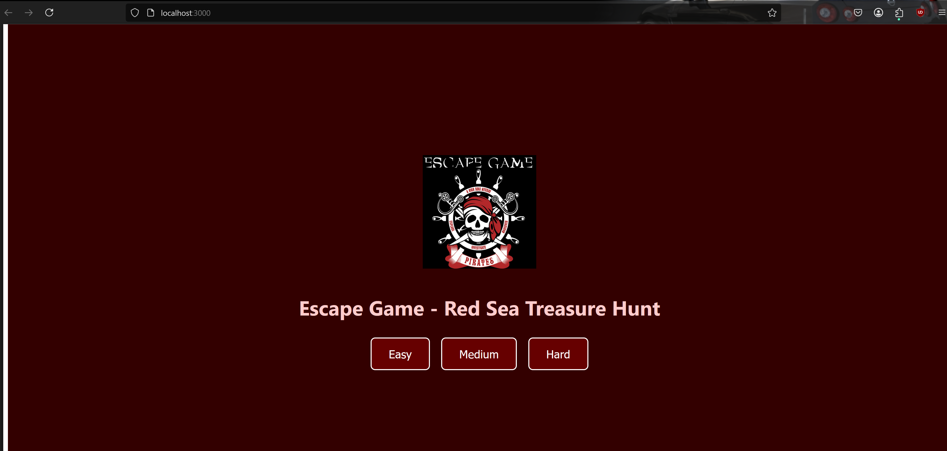
Version-1 without new modifications

Slide 14
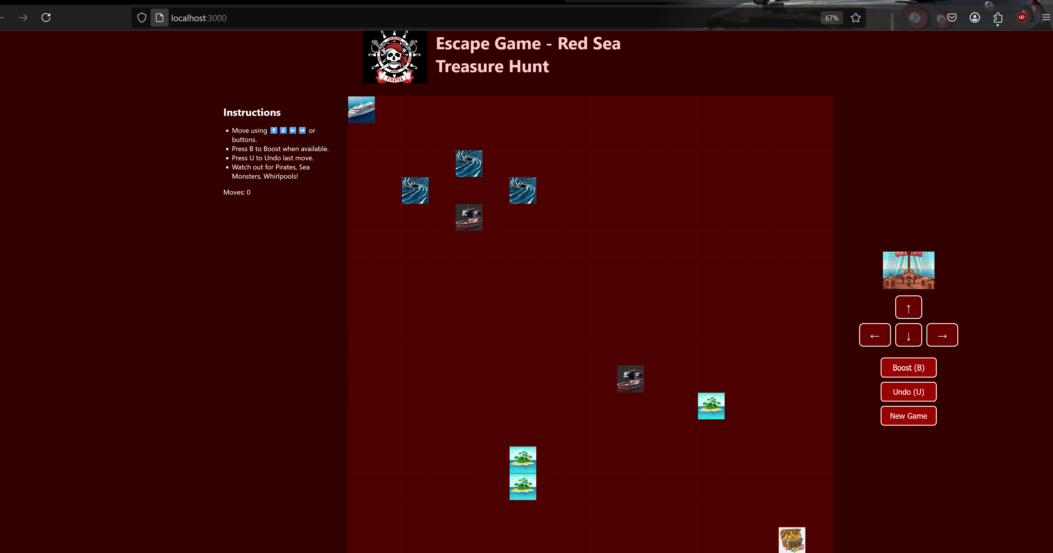
Version 1 (Before Changes)

Slide 16
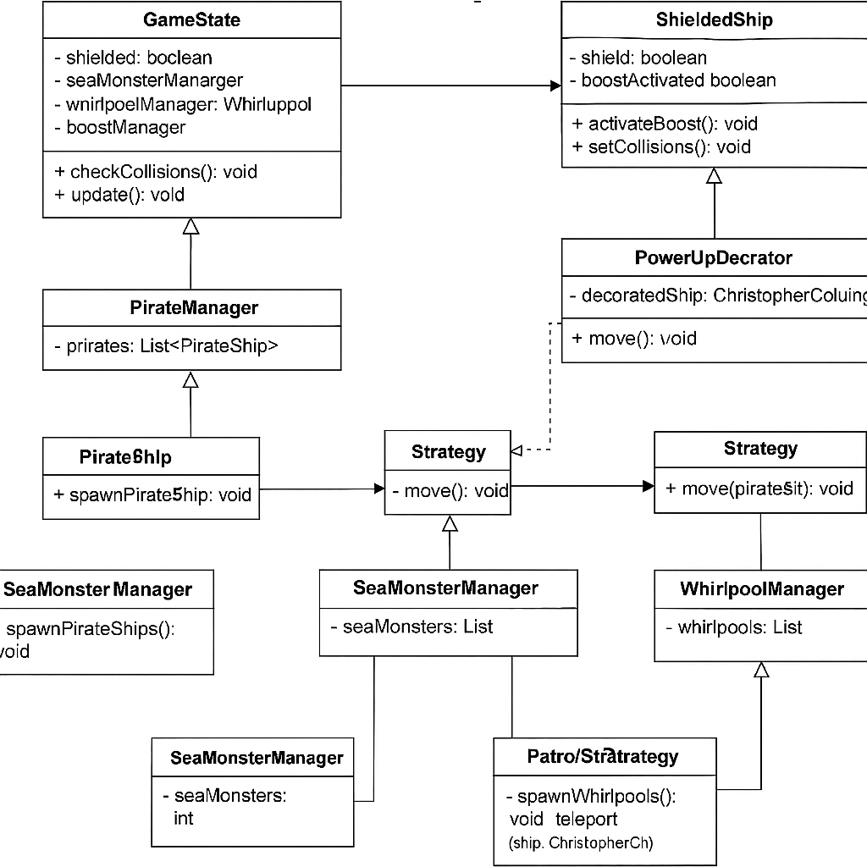
UML CLASS

Slide 17
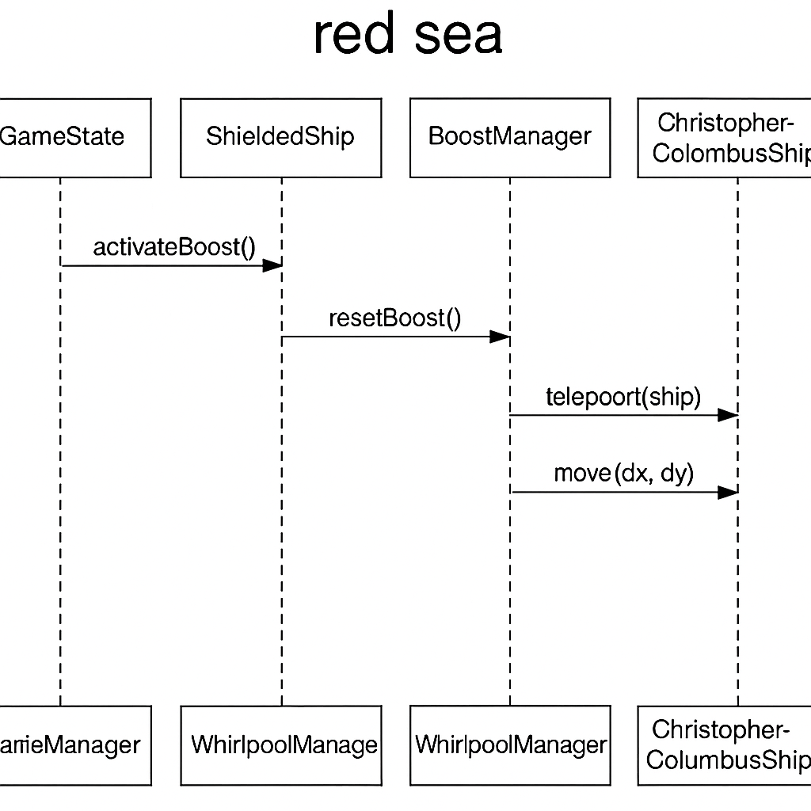
SEQUENCE DIAGRAM

